Slide 1



Static balancing and dynamic balancing
Ravi N

Slide 2

It is essential that rotor is to be mechanically balanced for smooth running without developing vibrations.
The rotor here includes complete rotor with slip rings, couplings etc.
The balancing can be achieved by adding or shifting weights fixed on the rotor for counter balancing or the material from the rotor drilled from heavy side.
The balancing can be achieved by 2 ways
Static balancing for low speed machines.(below 1000 rpm)
Dynamic balancing for high speed machine.(above 1000 rpm)

Slide 3
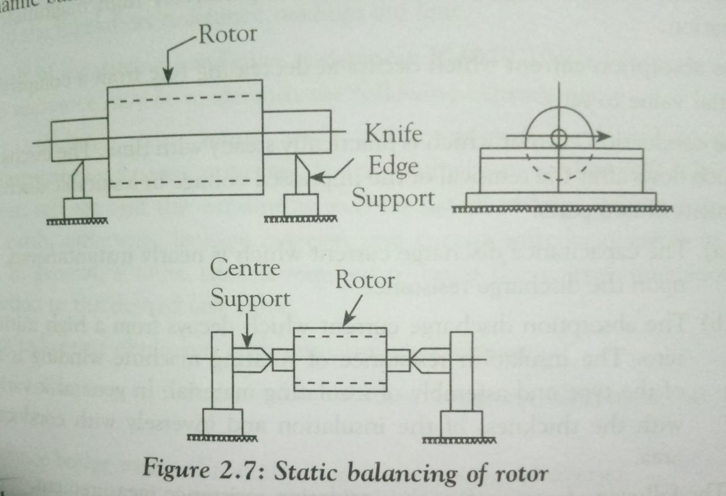
STATIC BALANCING:
The rotor to be balanced is fixed on a two knife edges of the balancing.
The centre or the knife edges must be in perfect horizontal plane.
A well balanced rotor will remain in standing in any position when turned about the axis in any direction, in any position and will not oscillate.
When the rotor is unbalanced, heavier side will always try to come down and the rotor cannot stay in any position.
The balancing is achieved by the aadition of weight or removing material from heavier portion of the rotor.

Slide 4
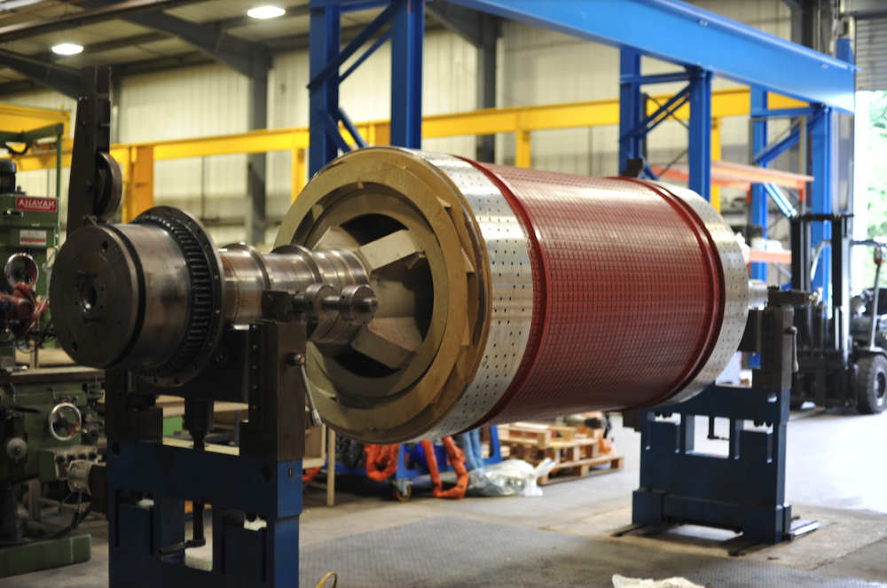
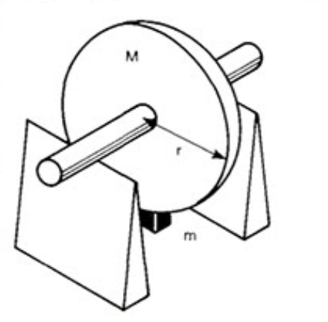

Slide 5

DYNAMIC BALANCING:
The rotor of the to be balanced is mounted on the axis of the balancing machine and driven at high speed.
if the rotor is unbalanced, it will vibrate at higher speeds.
To locate an unbalanced portion, one of the bearing is locked and the other is left free to vibrate.
An indicating needle is gently touched to the rotor and leaves a mark at the uneven portion.
The same is repeated by rotating the rotor in reverse direction.
The heavy portion lies between the two marks which is removed or counter weight is placed.

Slide 6
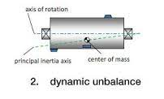


Slide 7

THANK YOU

Slide 8


The National Institute of Engineering
Department of Electrical and Electronics Engineering
Mananthavadi Road, Mysore-570008
HIGH VOLTAGE TEST
ON
3-Phase Induction motor as per Indian standard
I.S. 4029-1967
By
Sunil kumar S N
USN 4NI19EE108

Slide 9
HIGH VOLTAGE TEST
This test is conducted to check the capability of insulation of windings and the range of high voltage that the induction motor work safely.
The test voltage is of power frequency and sine waveform.
The value of maximum test voltage at site test is given by the expressions,
Vac(site) = 75% [2 x Rated voltage + 1000] volts.
Vac= 1.5 Rated line to line voltage

Slide 10
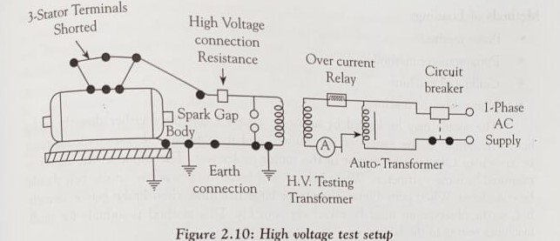
HIGH VOLTAGE TEST

Slide 11
HIGH VOLTAGE TEST
The three terminals of the motor are connected together and to the high voltage terminal of test supply.
The body is earthed and is connected to the earth terminal of test supply.
In this test, the test voltage is raised quickly to the maximum test voltage and kept applied for one minute and reduced slowly to zero.
If breakdown occurs, the test supply is automatically tripped.
The test is conducted on go/ not go basis.

Slide 12
While conducting the test, reference to the relevant standards and manufacturers instruction is to be made
Sl. No. | Part of motors | Test voltage (rms)
1. | Primary (stator) windings voltage with a min. of 200V. | 1000V plus twice the rated.
2. | Secondary (rotor) windings not. permanently short-circuited: For non-reversing motors or motors reversible from standstill only. For motors to be reversed or braked by reversing the primary supply while the motor is running | 1000V plus twice the open circuit standstill voltage as measured between sliprings or secondary terminals with rated voltage applied to the primary windings, with a min. of 2000V. 1000V plus four times the open circuit standstill secondary voltage with a minimum of 2000V.

Slide 13
THANK YOU

Slide 14
No Load Test On Induction Motor
The circuit model of an induction motor is similar to the transformer. Therefore, the circuit parameter of a model is also similar to the circuit parameter of a transformer. The No-load test of an induction motor is similar to the open-circuit test of a electrical transformer which is performed to determine the efficiency of motor and related circuit parameters of three phase induction motor.
This test is performed in an induction motor to determine no-load current I₀, no-load power factor cosϕ₀, fiction and windage loss P_{wf}, no-load core loss P_{i}, no-load power input P_{o}, and no-load resistance R₀ and reactance X₀.
For small size motors, we can determine performance parameters by directly applying to load. But in the case of a large motor, it is inconvenient to apply a large load in the laboratory. Hence, for this type of motor, the no-load test is convenient to determine performance parameters.

Slide 15
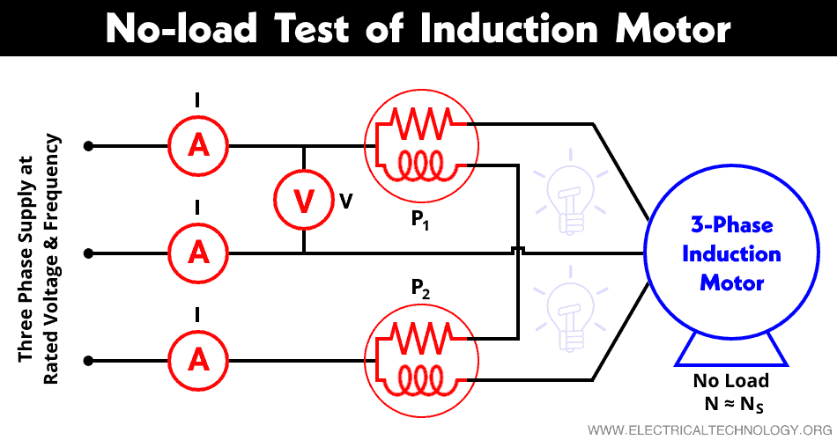
Circuit Diagram

Slide 16
An ammeter A and voltmeter V are connected as shown in the figure to measure the no-load current and the rated supplied voltage respectively. To measure the input power two-wattmeter method is used. Hence, two watt-meters P₁ and P₂ are connected as shown in the figure to measure the input power.
In a no-load test, the motor is running without load. Hence, the power factor is less than 0.5 and the total power input is equal to the sum of two wattmeter readings. One wattmeter will show negative reading. So, it is necessary to reverse the direction of current coil terminals to take a proper reading.
P_{constant} = P₁ + P₂
At no-load, input power is equal to the core loss, stator copper loss, and friction and windage loss. In no-load condition, the current that passes through the circuit is very small (approx. 20-30% of rated current) and the slip is extremely small (in order of 0.001). Therefore, the I²R loss in stator winding can be neglected as it varies with the square of the current.

Slide 17
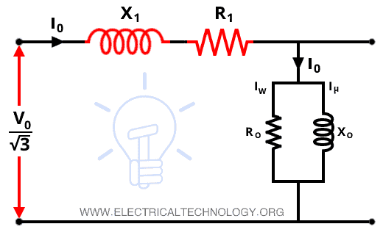
Equivalent Circuit

Slide 18
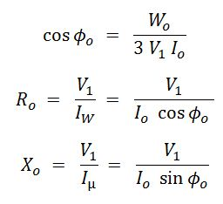
Calculation of No-Load Test of Induction Motor :
Let W_{o} = Power input.
V₁ = Applied voltage per phase.
I_{o} = Applied current per phase under no- load conditions.
Then the no-load power factor is,

Slide 19


The National Institute of Engineering
Department of Electrical and Electronics Engineering
Mananthavadi Road, Mysore-570008
A Presentation on,
LOCKED ROTOR TEST
By,
Darshan B K
USN:4NI19EE019
Under the Guidance of,
Ms. Reshma P
Department of Electrical and Electronics Engineering

Slide 20
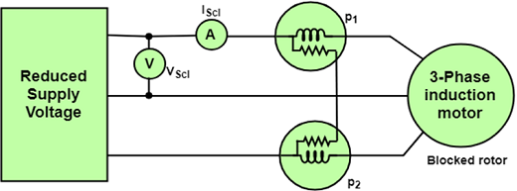
Locked Rotor Test
Locked rotor test is conducted to determine the starting current,starting torque,power factor and impedance.
This test is carried out by holding the rotor stationary by clamps.
Locked rotor test gives copper loss for particular stator current.

Slide 21
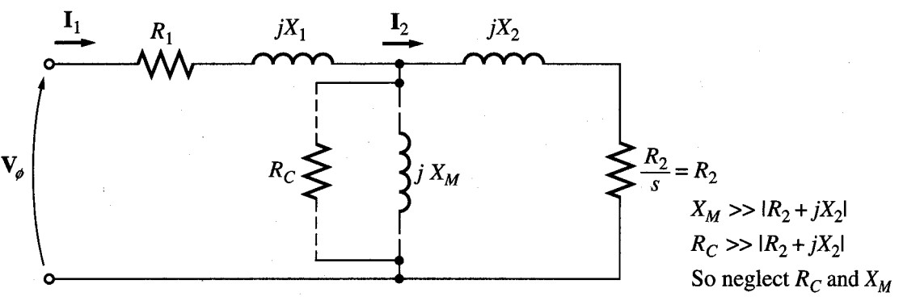
In this test, the rotor is locked or blocked so that it cannot move, a voltage
is applied to the motor, and the resulting voltage, current and power are
measured.
The AC voltage applied to the stator is adjusted so that the current flow is
approximately full-load value.

Slide 22
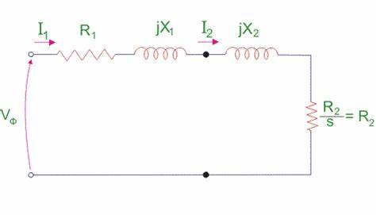
Now,as the rotor is blocked,slip s=1 hence the magnetizing reactance is much higher than the rotor impedance and it can be neglected.
Hence the equivalent circuit reduced to.

Slide 23
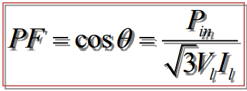
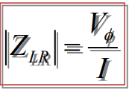
• The locked-rotor power factor can be found as
The magnitude of the total impedance

